Slide 1
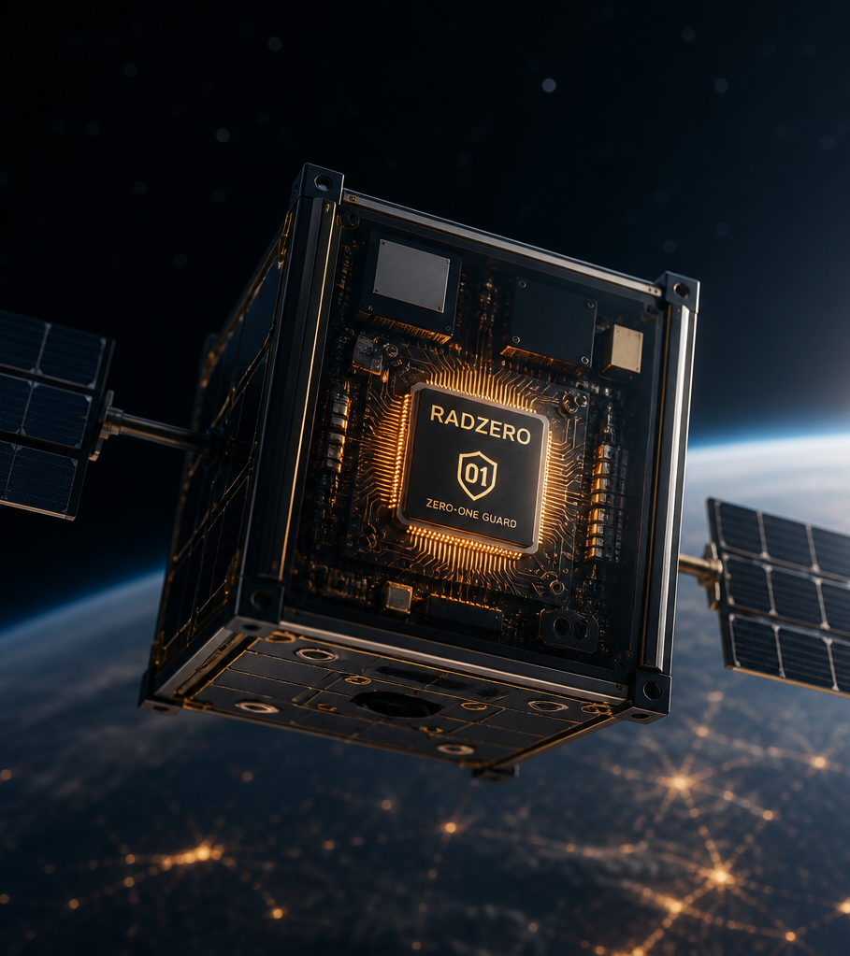
Securing Orbital
Intelligence
Through
Physics-
Validated
Resilience
RadZero delivers real-time fault containment and sub-
millisecond recovery for high-reliability AI hardware in
radiation-heavy environments.

Slide 2
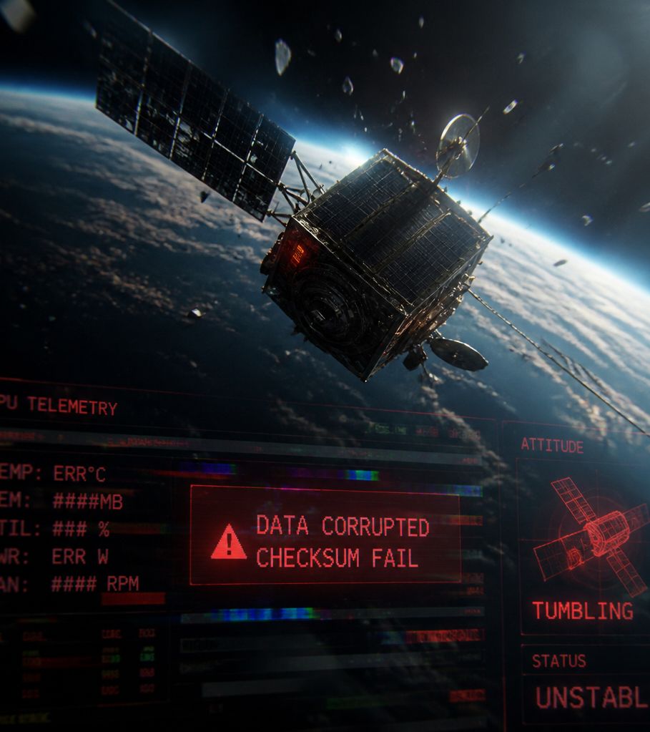
The Threat to Orbital AI
The Silent Killer in Orbit
COTS GPUs: The backbone of modern orbital AI,
providing high compute density but low inherent radiation
tolerance.
Ionizing Radiation: Particles trigger physical bit-flips and
Single Event Upsets (SEUs) in local memory.
Silent Data Corruption (SDC): Bit-flips alter AI weights or
inference logic, leading to erroneous flight commands and
fatal spacecraft tumbles.
Operational Impact: Cold reboots are currently the
primary recovery mechanism, resulting in 6-hour mission
blackouts and loss of critical telemetry.

Slide 3
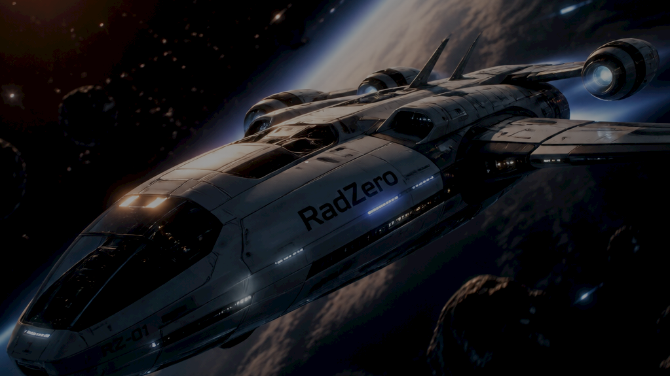
The spacecraft went into a death spiral. RadZero
detected the bit-flip and corrected the torque
command in under a millisecond, saving the mission.

Slide 4




RadZero vs. Existing Approaches
Comparative Architectural Matrix
Feature
TMR
Scrubbers
RadZero
Dynamics-Aware
Actuator Protection
Recovery Latency
High
10s-60s
0.68ms
SWaP-C Overhead
+200%
Moderate
Minimal

Slide 5

Our Solution: Physics-Aware Fault Containment
Bridging AI Inference with Newtonian Dynamics
Coupling AI
  Seamlessly integrates neural inference with spacecraft rigid-body
  dynamics.
Validates Torque
  Real-time verification of control inputs against fundamental Euler
  equations.
Eliminates Unphysical Commands
  Instantaneous interception and correction of commands that violate
  physical constraints.
Protects Mission Integrity
  Ensures flight safety and stability without compromising system
  efficiency or AI performance.

Slide 6
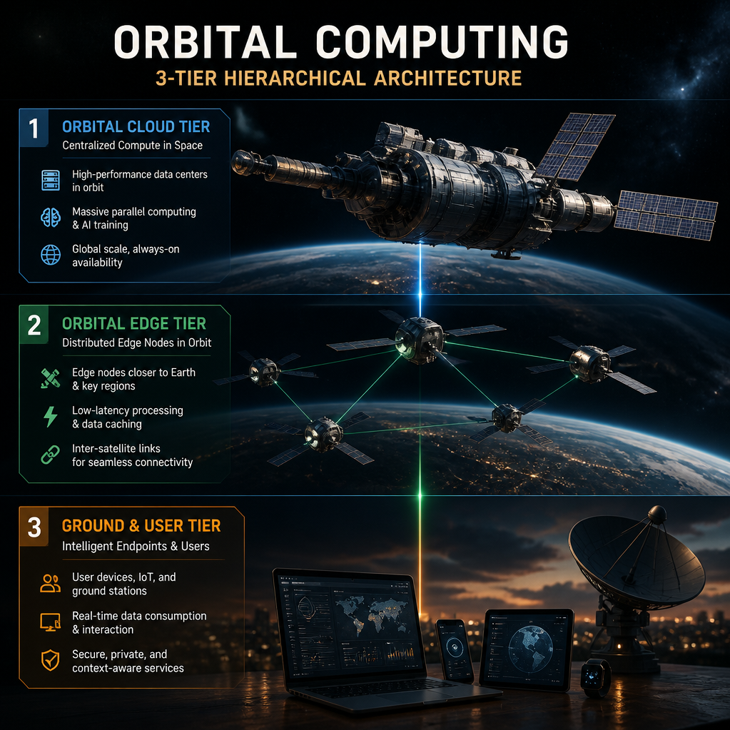
The 3-Tier Defensive Architecture
Multi-Layered Protection for Orbital Computing
Tier 1: In-line AI Tripwires
  Real-time threat detection at the edge with latency under 0.15ms.
Tier 2: Rigid-Body Dynamic Gate
  Enforcement of strict access control policies and dynamic state analysis
  for incoming traffic.
Tier 3: Asynchronous Cyclic Memory Scrubber
  Continuous background integrity monitoring with autonomous
  identification and purging of corrupted data.

Slide 7
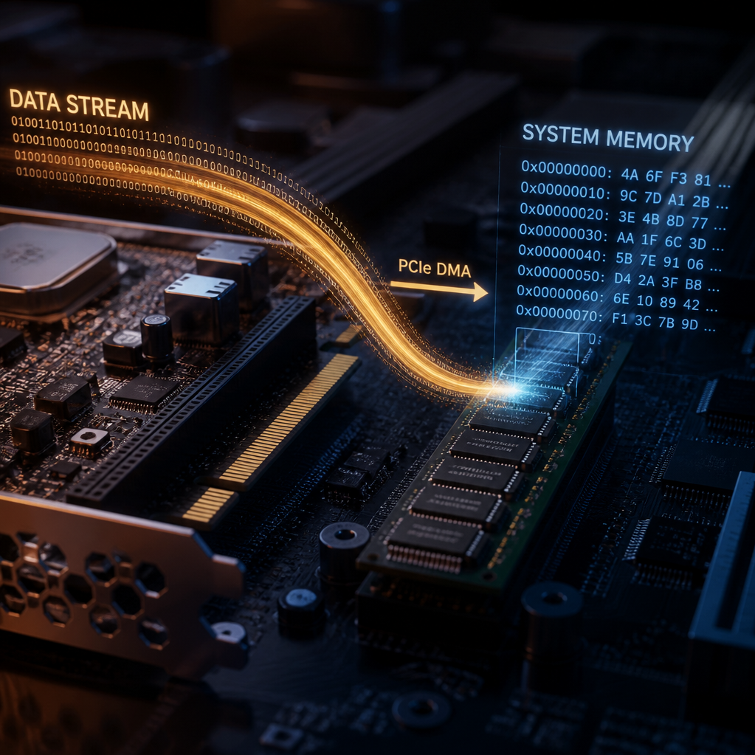
Innovation: In-Situ Hot-Patching
Recovery Without System Reboots
Real-time Patching
  Utilizes PCIe DMA for direct memory injection.
Performance Speed
  Achieves a mean recovery time of just 0.68 milliseconds.
Zero Downtime
  Allows for continuous, uninterrupted process execution during updates.
Operational Continuity
  Maintains system availability throughout the entire fault mitigation
  lifecycle.

Slide 8
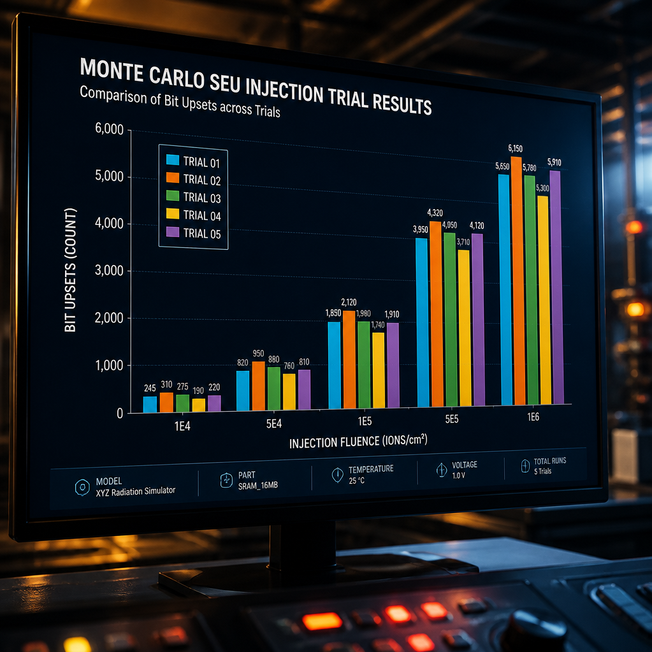
Performance Benchmarks
Validated Resilience in Extreme Conditions
50/50 Monte Carlo Trials
  Robust validation through comprehensive SEU injection testing.
Recovery Speed
  Achieved 58.8x faster recovery than documented project targets.
Operational Continuity
  Maintained 100% uptime during live fault patching scenarios.
System Efficiency
  Negligible performance footprint with <0.2% total compute overhead.

Slide 9
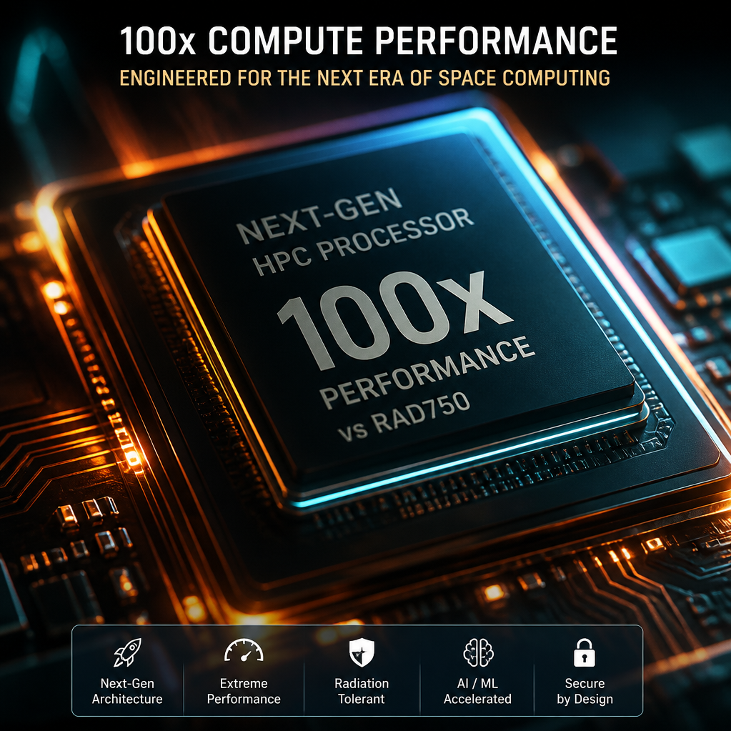
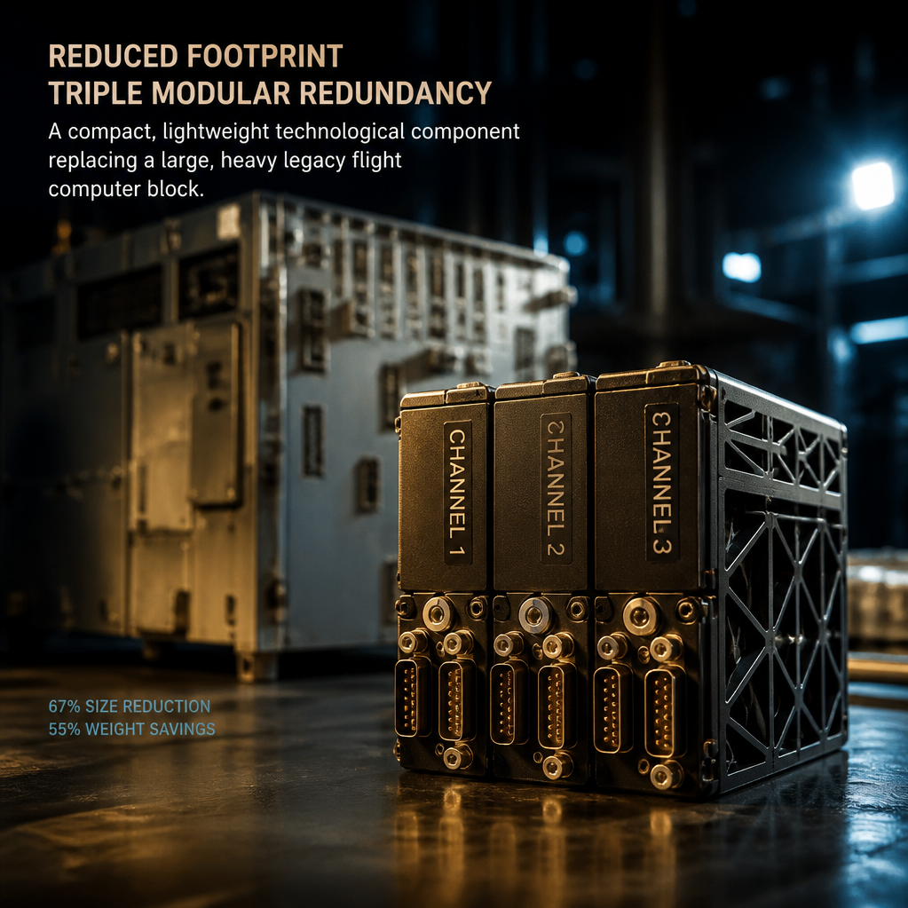
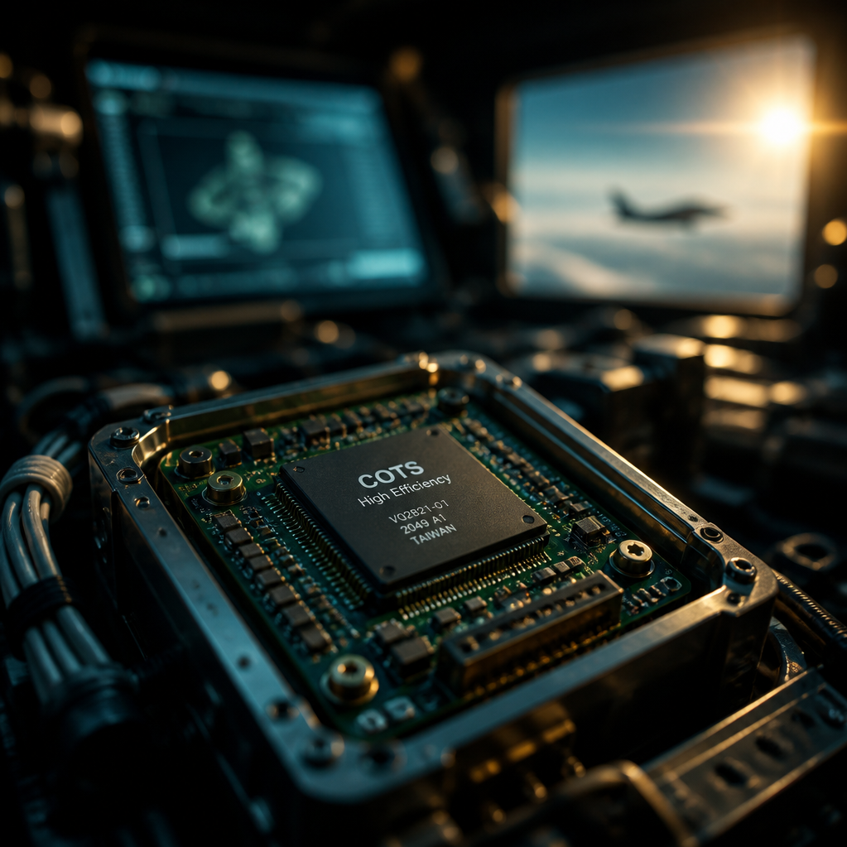

Optimizing SWaP-C for Future Missions
High-Performance Compute at Low Cost
100x Compute Performance
Reduced Footprint
COTS Efficiency
Adaptive Scalability
Delivers a significant
performance leap compared
to legacy RAD750 systems.
Eliminates the need for
bulky hardware-based Triple
Modular Redundancy.
Maximizes the efficiency of
Commercial Off-The-Shelf (COTS)
silicon for onboard processing.
Features an architecture
specifically optimized for
modern swarm constellations.

Slide 10
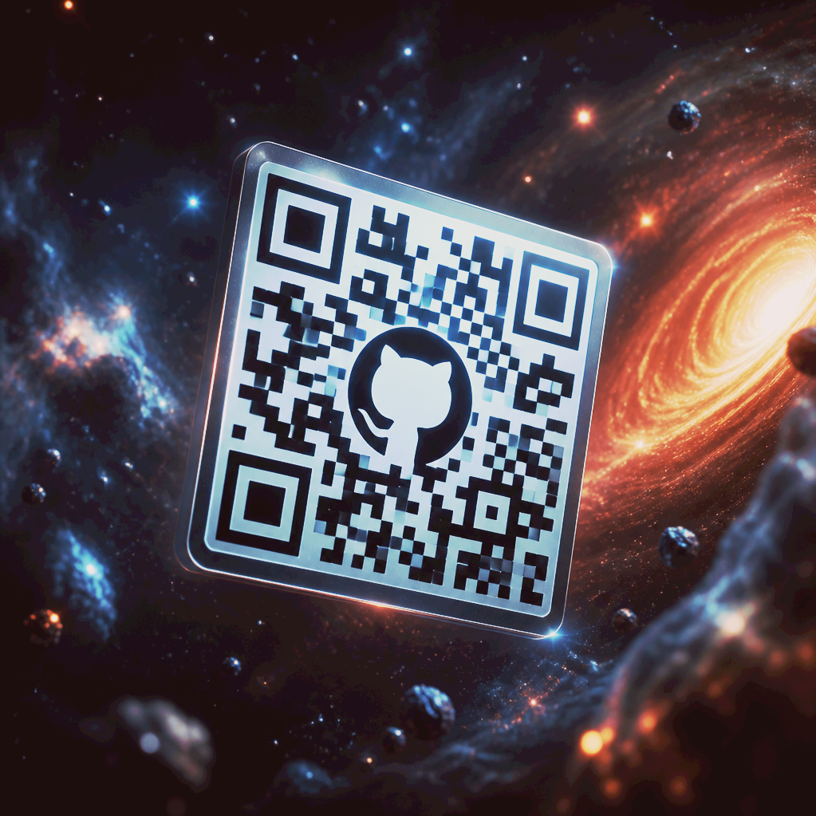
Join the Open-
Source
Community
github.com/zog-ai
Physics-validated AI for mission-critical autonomy

